Slide 1

Web-based interactive visualization
Zengxiang
Jan 21th 2021
@ West Lafayette, IN

Slide 2
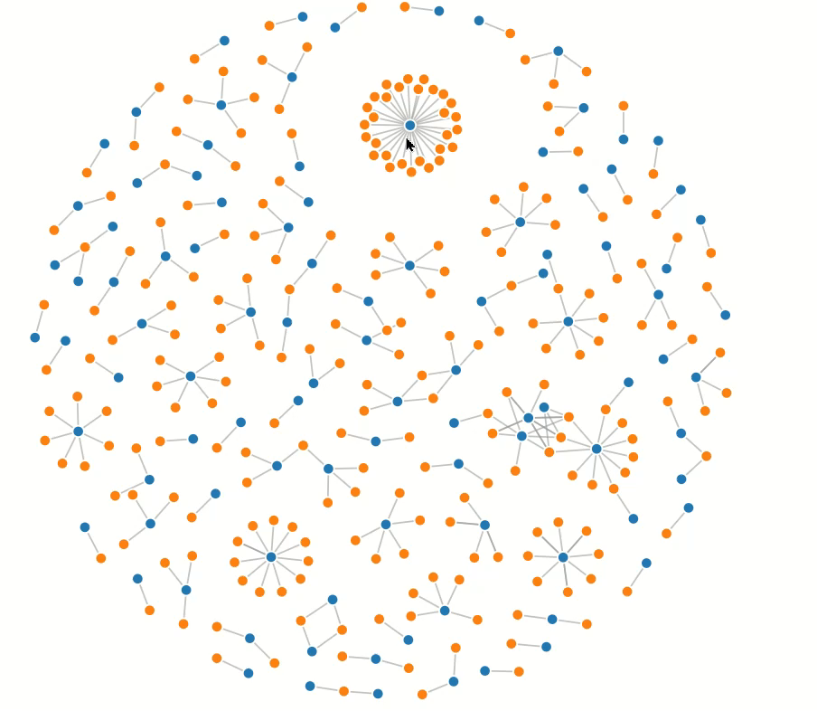
Introduction
JavaScript (JS) is a high-level, (often) just-in-time complied programming language.
As a core technology of the WWW, JS is widely used for rendering webpages, and all major web browsers have a dedicated JS engine to execute it.
Together HTML and CSS, JS enables interactive web pages, so as interactive visualizations.
These slides will briefly show how to build a web-based interactive visualization by mainly using two JS packages (React.js, Deck.js).
An example of interactive visualization
Source: https://observablehq.com/@d3/disjoint-force-directed-graph

Slide 3


Preparation
To execute JS, we need a JS engine…
To make life easier, we need a coding environment…
https://nodejs.org/en/
https://www.jetbrains.com/webstorm/

Slide 4
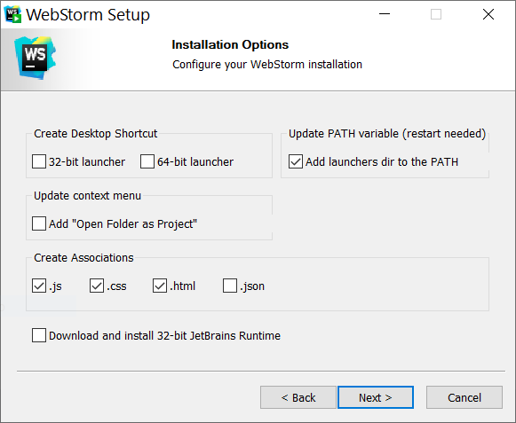
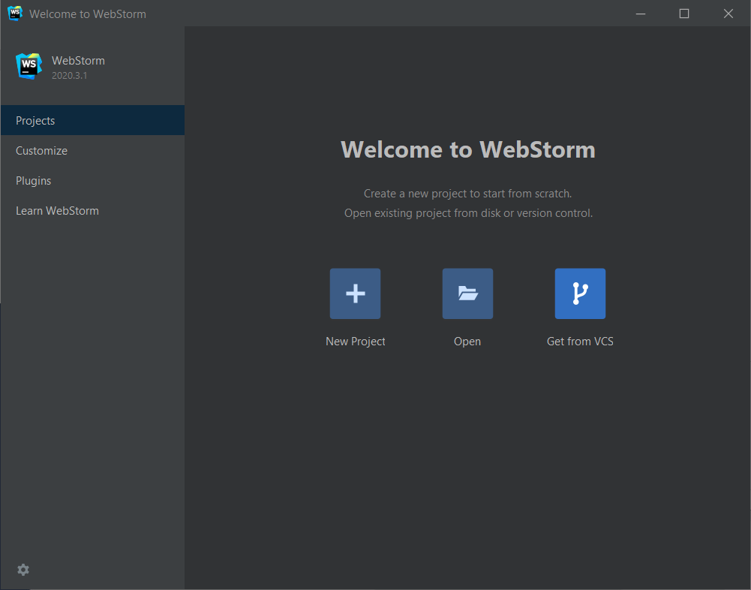
Preparation
For Node.js, proceed by following the instruction. It may pop a terminal window for installing additional tools. In that case, “type any key to continue”.
For Webstorm

Slide 5
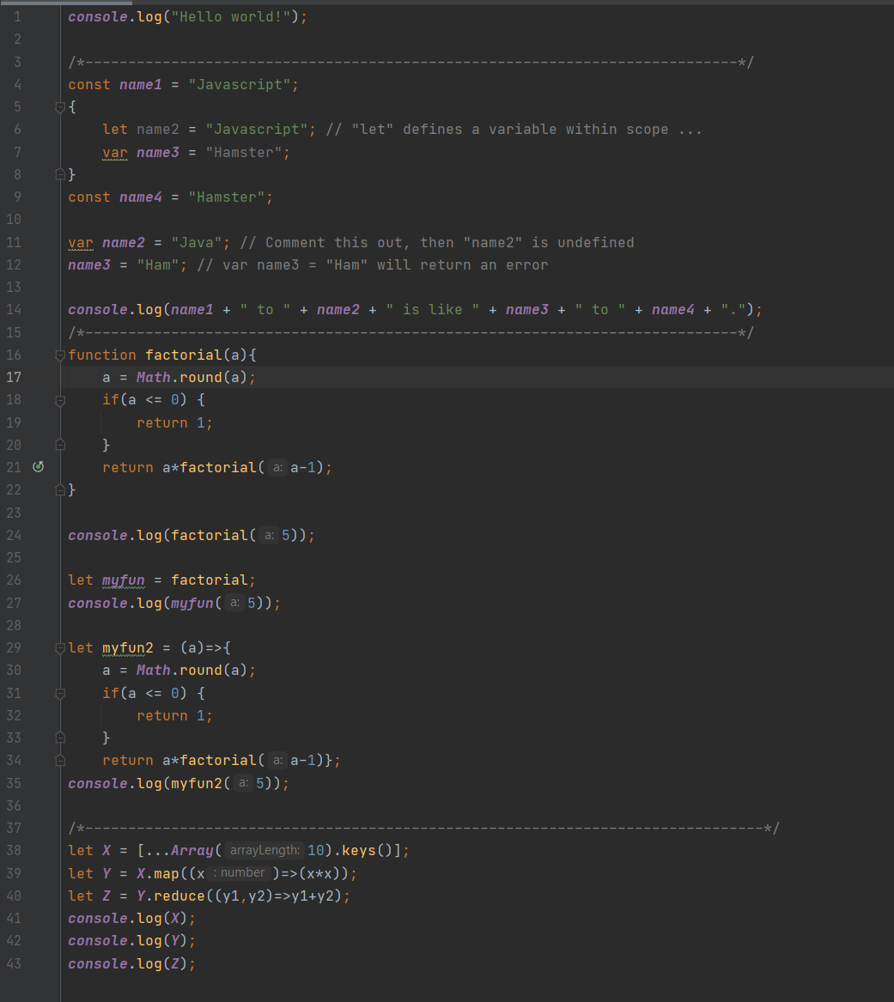
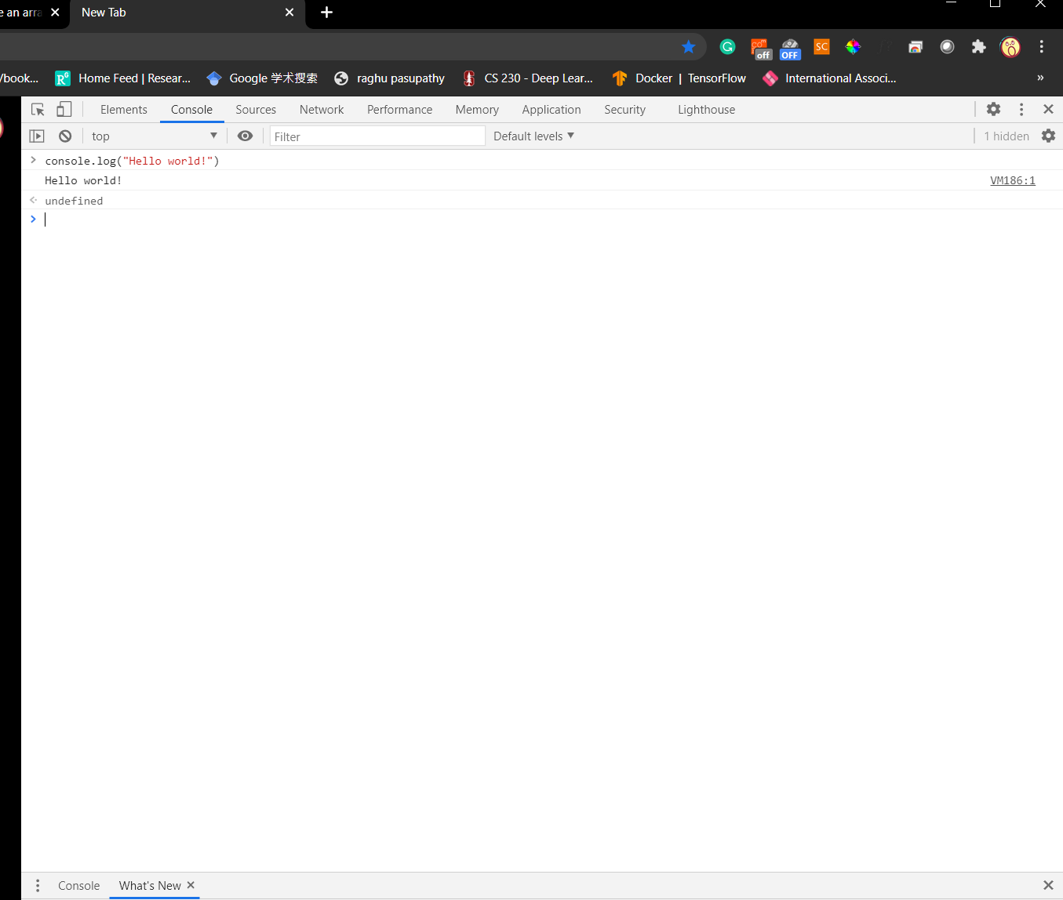
JS Syntax

Slide 6
React.js
React is an opensource JavaScript library for building user interfaces contributed by facebook.
Preliminaries:
JSX: a syntax for defining HTML element in JS, e.g.,
const element = <h1>Hello, world!</h1>;
Embedding expressions in JSX
const element = <h1>Hello, {name}!</h1>;
where name is a JS variable.
In Session1\ directory, run “npx create-react-app 2_react.js”

Slide 7
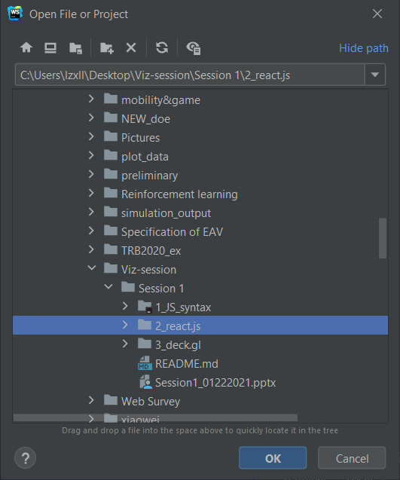
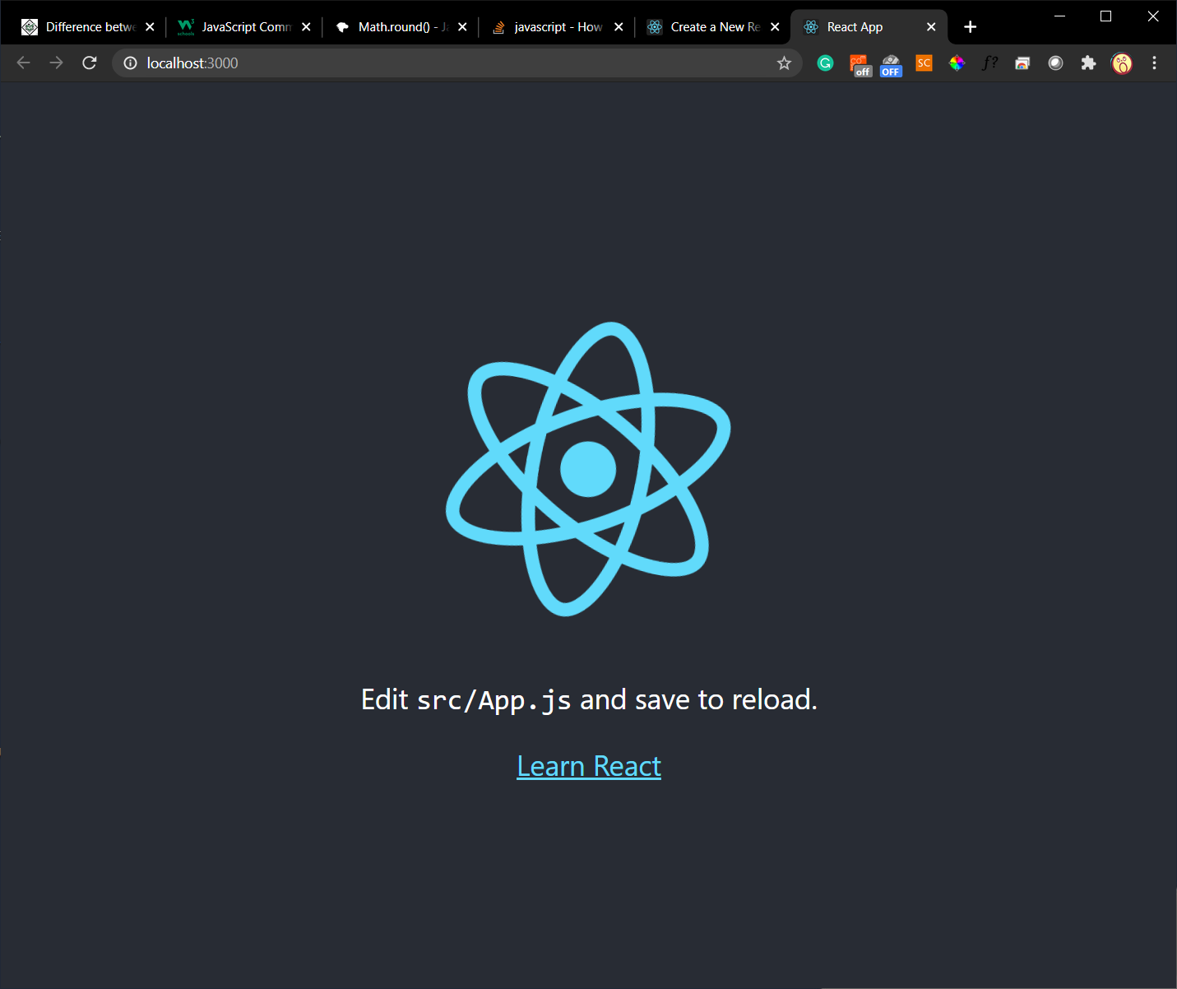
React.js
Open project

Slide 8
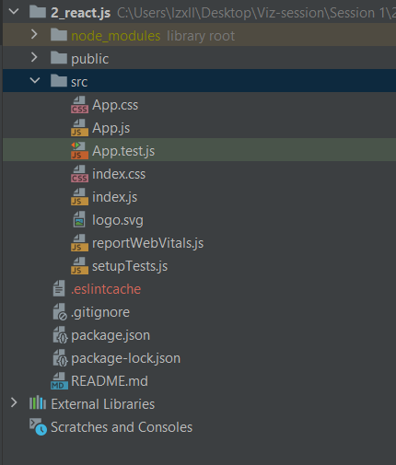
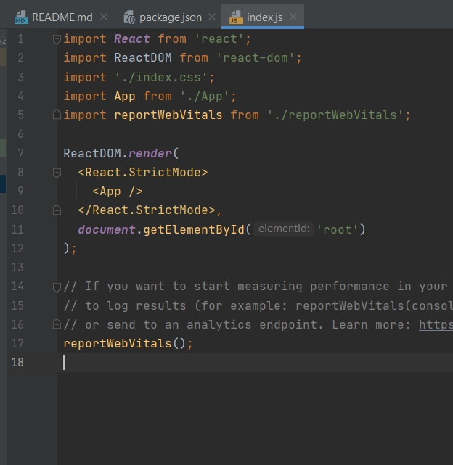
React.js
Source code
JSX
Configuration

Slide 9
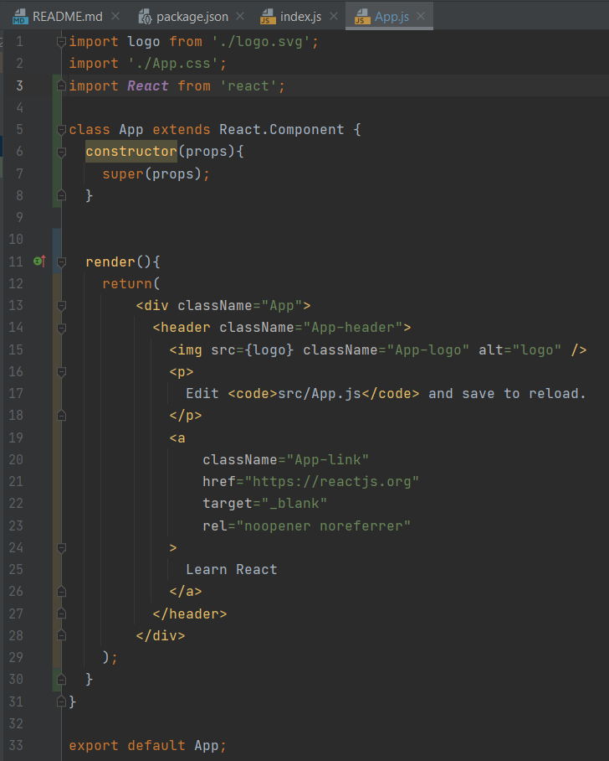
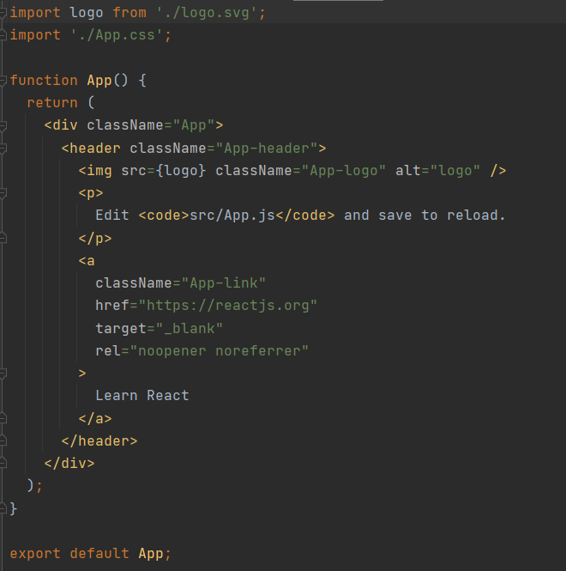
React.js
JSX

Slide 10
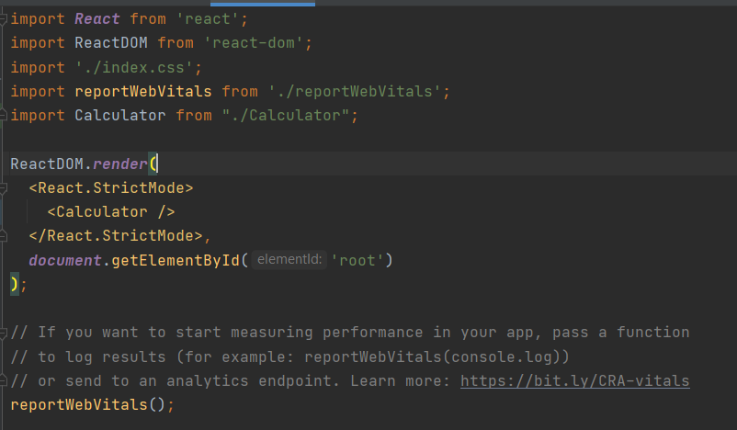
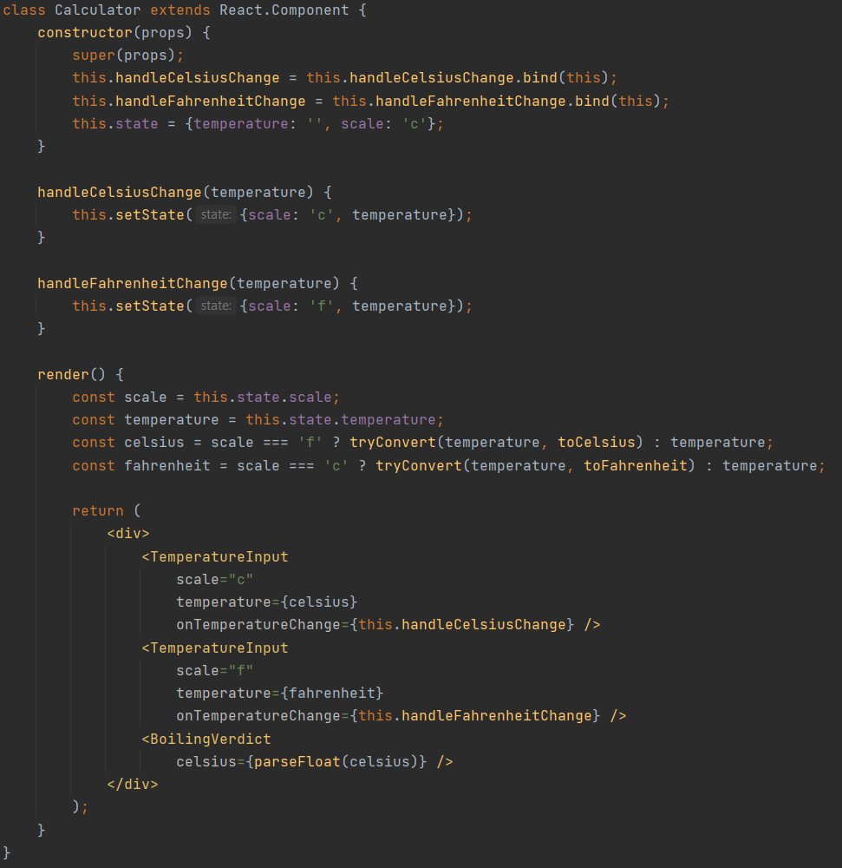
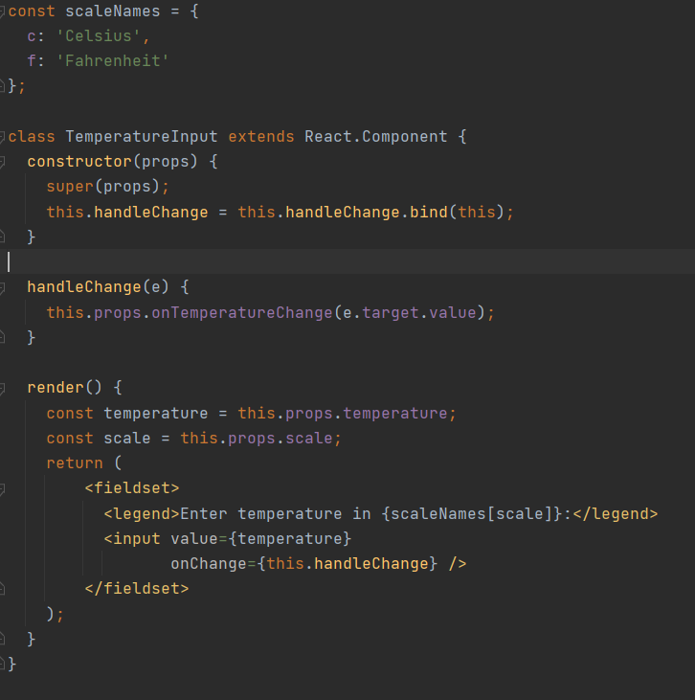
React.js
State
Props
State
Props
Index.js
Calculator.js
TemperatureInput.js
Notes:
This example comes from https://reactjs.org/docs/lifting-state-up.html

Slide 11
Deck.gl
Deck.gl is a WebGL-powered framework for visual exploratory data analysis of large datasets powered by Uber.
https://deck.gl/examples
To use Deck.gl:
Import a layer from deck.gl package.
Call the Layer using JSX.

Slide 12
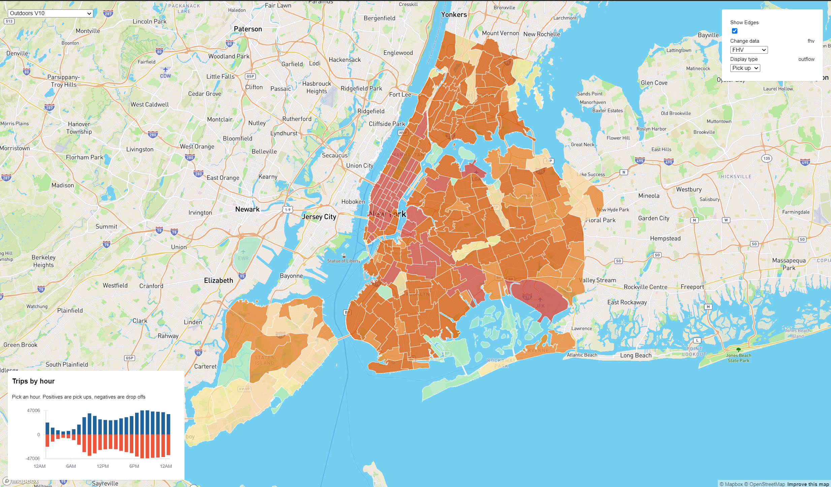
Deck.gl
https://deck.gl/docs/api-reference/layers/arc-layer
https://deck.gl/docs/api-reference/layers/scatterplot-layer
https://deck.gl/docs/api-reference/layers/geojson-layer

